Slide 1

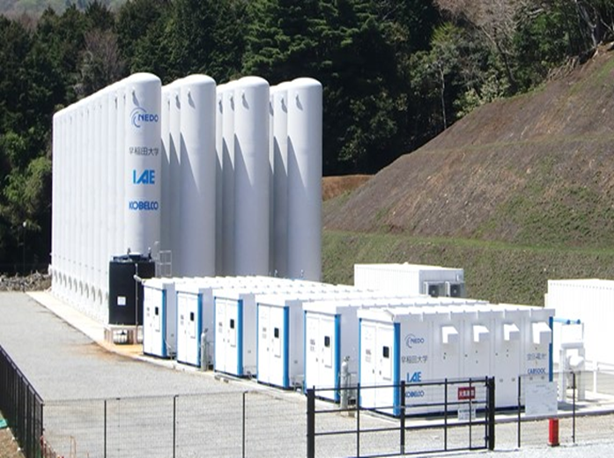
KAB
KOBELCO AIR BATTERY
Adiabatic Compressed Air Energy Storage
Emission Free
Economical
Efficient
KOBELCO is looking for partners to work with in North America
TM

Slide 2

Table of Contents
About KOBELCO / VISION
About the KABTM A-CAES System
Value Comparisons
    Versus GT-CAES
    Versus Li-Ion Batteries
Summary
Appendices

Slide 3
KOBELCO CORPORATE PROFILE
COMPANY NAME | Kobe Steel, Ltd.
FOUNDED | September 1, 1905
INCORPORATED | June 28, 1911
CAPITAL | JPY250.9billion (as of March 31, 2019) US$2.5billion
PRESIDENT & CEO | Mitsugu Yamaguchi
NUMBER OF EMPLOYEES | 39,341 (Consolidated, as of March 31, 2019) 11,401 (Nonconsolidated, as of March 31, 2019)
SUBSIDIARIES | 218 (as of March 31, 2019)
AFFILIATED COMPANIES | 52 (as of March 31, 2019)
Machinery Division URL
https://www.kobelco.co.jp/english/machinery/

Slide 4
KOBELCO’S VISION
To introduce KOBELCO DRY SCREW COMPRESSOR, a SUPERIOR TECHNOLOGY since 1955
Oil Free Dry Screw is the best fit for an A-CAES system. KOBELCO’s outstanding technology can achieve Emission Free, Economical, Efficient A-CAES systems in North America.
To make KAB SYSTEM (NEW A-CAES) popular in ENERGY STORAGE projects in North America
CAES is one of the most economical systems in Energy Storage industry as shown in DOE report in 2020. Although existing GT-CAES systems (Alabama) emit a lot of carbon, KAB system uses only Air and Water and no fossil Fuels.
To improve IMBALANCED ENERGY SUPPLY and DEMANDS for INDUSTRY and SOCIETY
Renewable Energy resources suffer losses by imbalanced supply of Energy compared to customer demand. KAB can efficiently store surplus Energy from Renewables and discharge it in most effective way to achieve profitable operation.

Slide 5
Table of Contents
About KOBELCO / VISION
About the KABTM A-CAES System
Value Comparisons
    Versus GT-CAES
    Versus Li-Ion Batteries
Summary
Appendices

Slide 6
ADVANTAGES of KABTM SYSTEM
Emission Free (No CO₂)
Designed to use the power from renewable energy resources.
Zero Emissions during operation. Adiabatic CAES without gas turbine, which uses only Air and Water.
2. Economical
By using Salt Cavern as air storage, outstanding cost reduction will be achieved for long duration (over 4 hours), which is supported by DOE report in 2020.
One KAB system could be used both for Compressor and Expander.
3. Efficient
Minimize the loss of power during charging/discharging by using Dry Screw Compressor.
Store excess intermittent energy from renewable resources and sell dispatchable stored energy when market prices are higher.
KAB SYSTEM (KOBELCO Official YouTube Channel)
https://www.youtube.com/watch?v=olrgy2P9wSA

Slide 7
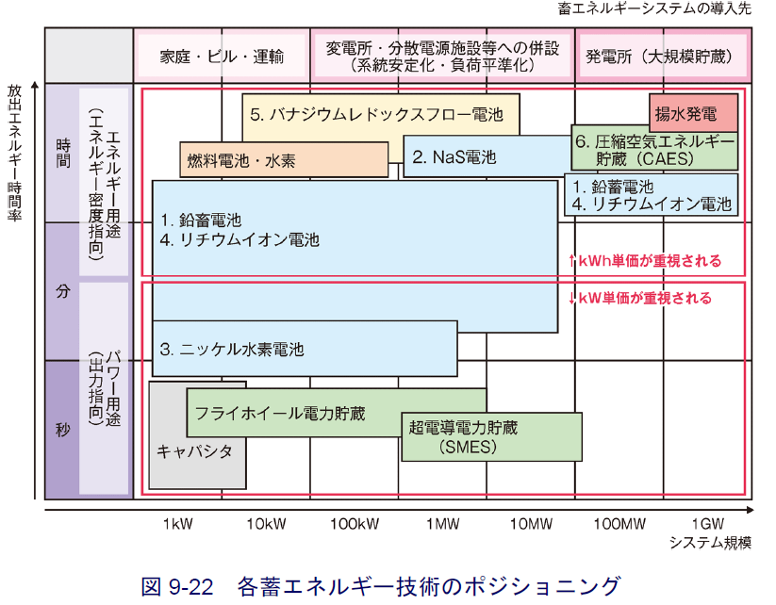
POSITIONING OF CAES
in energy storage technology
Buildings, transport
With Substation and power supply system
(For system stability and load leveling)
Power plants
(large storage)
Vanadium Redox flow battery
CAES
pumped-storage
hydroelectricity
hours
Hydrogen and fuel cells
NaS battery
Energy discharge time
Focus on capacity
Lead-acid battery
Li-ion battery
minutes
NiMH battery
Focus on output
power
seconds
Flywheel battery
Superconducting magnetic
energy storage
Capacity
Positioning of energy storage technology
System scale
～NEDO renewable energy technology, the second edition～
Notes:
Variety of Accumulator and Compressed air battery 各種蓄電池と空圧電池の比較
負荷平準化システム 例文帳に追加
LOAD LEVELING SYSTEM
系統安定化装置（System Srabilizing Controller：SSC）全体外観〈九州電力株式会社〉
--------
This screen shows various kind of battery for various storage time and output. Generally chemical battery is applied for small capacity, and for the large scale pumped hydro storage or in future H2 storage would appear.

Slide 8
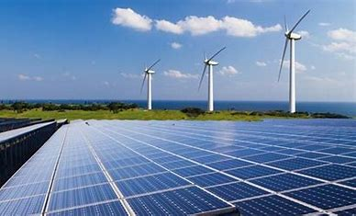

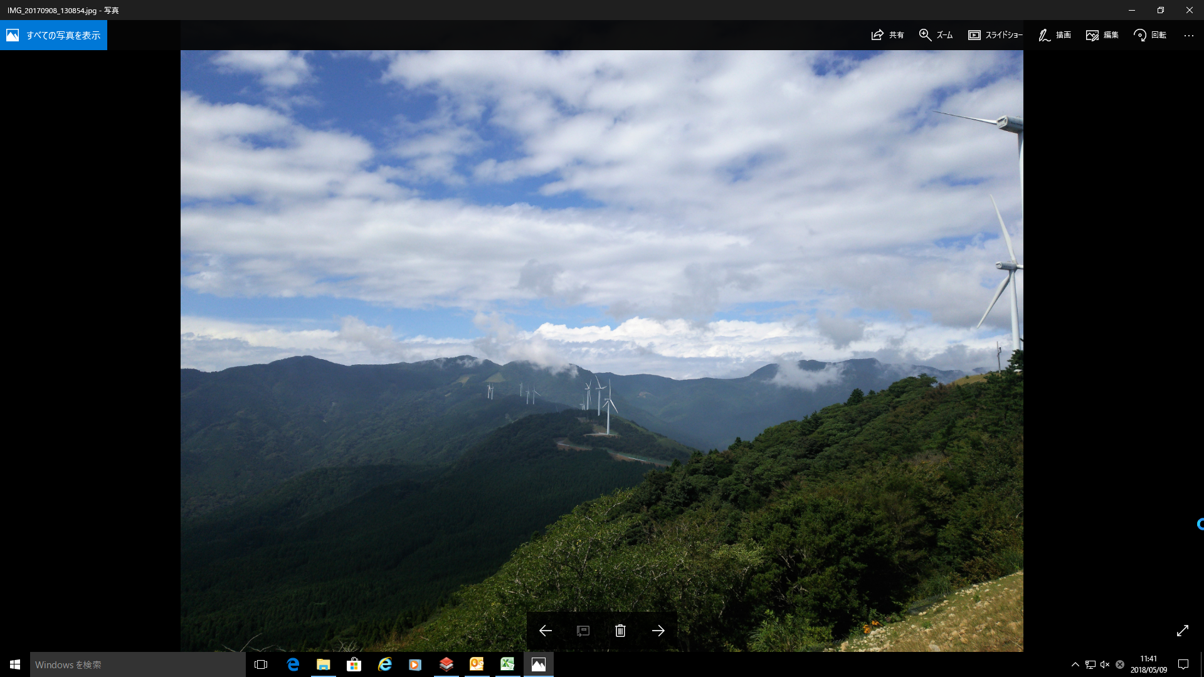
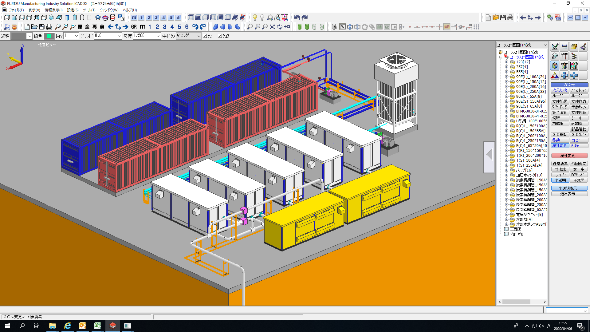
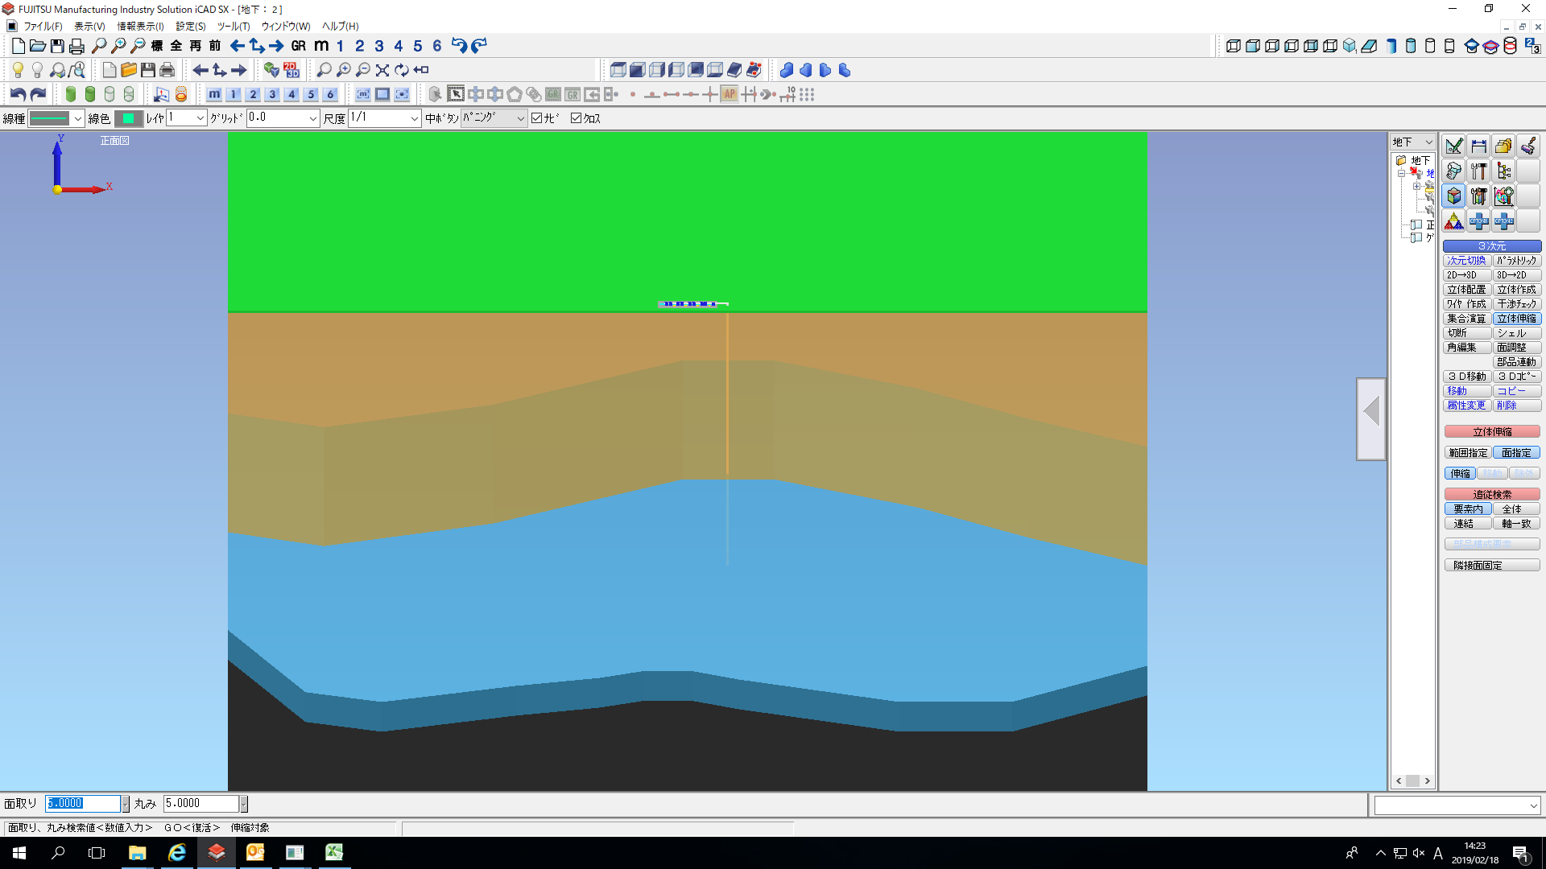
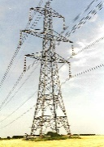
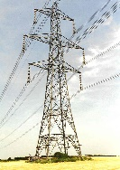
OUTLOOK of KABTM SYSTEM
Emission Free
Effective
Economical
RENEWABLE ENERGY
CONNECTED CITY
KABTM SYSTEM
Container with
Compressor/Expander
Heat Exchanger
Generator
HEAT MEDIA STATION
Container Tank
KAB SYSTEM
AIR STORAGE
EXISITING SALT CAVERN
AIR

Slide 9
PROCESS of KABTM SYSTEM
POWER GRID
Suction air
Power Fluctuation
<PV,WF><Demand>
Exhaust air
Charge
Discharge
Dry Screw Compressors / Expanders
Motor / Generator
Heat Storage
Heat Exchanger
High temperature
Heat medium
Compression heat collection
Preheating
Low temperature
Heat medium
Charge / Discharge Unit
Air Storage
Notes:
風力発電機の出力電力変動抑制装置
OUTPUT ELECTRIC POWER FLUCTUATION RESTRAINING DEVICE OF WIND POWER GENERATOR - 特許庁
A monitor controller 31 computes and sets an output of a power system 5 for adjustment from such information so as to keep the balance of demand and supply, including the naturally fluctuating electric power supply 4.
熱媒体液及び熱媒体液の過熱防止方法 例文帳に追加
HEATING MEDIUM LIQUID AND METHOD FOR PREVENTING SUPERHEATING OF HEATING MEDIUM LIQUID - 特許庁
また、ガス温度調整室に導入される高温熱媒体に、低温熱媒体を混合する低温熱媒体供給通路、低温熱媒体供給部及び低温熱媒体供給弁と、低温熱媒体供給弁制御部とを備える。
The vaporizer 1, also, comprises a passage to supply low-temperature heating gas for mixing it with the HG flowing into the room 30; and a supply unit with a valve and a control unit with a valve, these are for the low-temperature heating gas.
発電する
generate electricity

Slide 10
Table of Contents
About KOBELCO / VISION
About the KABTM A-CAES System
Value Comparisons
    Versus GT-CAES
    Versus Li-Ion Batteries
Summary
Appendices

Slide 11
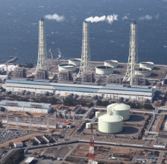
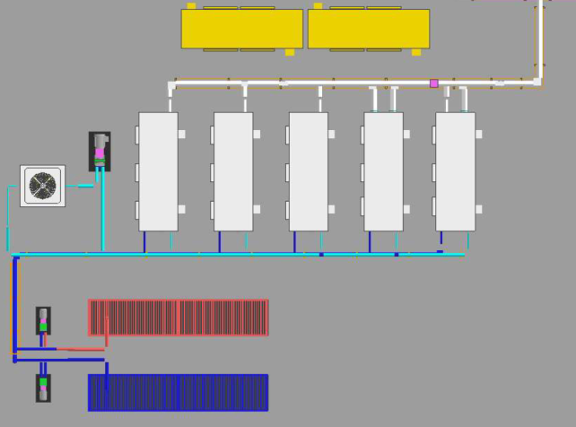
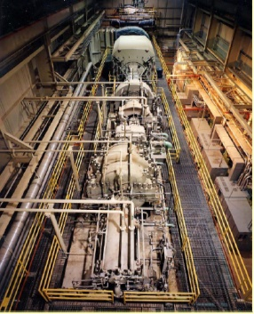
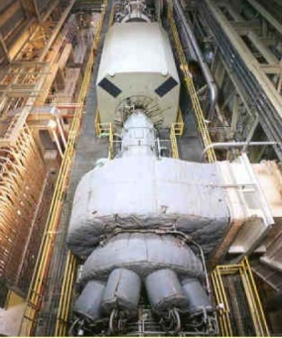
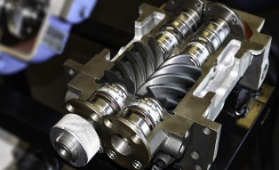
DRY SCREW vs. GT-CAES (TURBO)
Outline of both systems
FUEL POWER PLANT
Flexibility of Dry Screw makes KAB able to operate with only Renewable Energy input.
100% by renewable plant
Need Fuel support to operate
100MW
Turbo Comp.
100MW
Gas Turbine
CHARGE
CAVERN
CAVERN
FUEL
DISCHARGE
KOBELCO DRY SCREW
GT-CAES (TURBO) COMPRESSOR
(ex. McIntosh, ALABAMA)

Slide 12
DRY SCREW vs. GT-CAES (TURBO)
advantages of Dry Screw
High PERFORMANCE RESPONSE
Dry Screw Compressor / expander can adjust input / output power with extreme flexibility by wide adaptability of rotational speed. It realizes high performance response to the requirement signal ( charge / discharge ). ⇒ In contrast, Turbo compressor does not fit as Renewable Energy Storage as they do not have flexibility to requirement signal.
Achieved HIGH PRESSURE as DRY SCREW TYPE
KOBELCO has successfully upgraded Dry Screw Compressor capable to be used with high pressure , which will fit as alternative of GT-CAES (Turbo compressor is standard) and realize emission free Energy Storage system.
ONE SCREW TYPE machine can be used for BOTH DIRECTIONS
KOBELCO DRY SCREW machine can be used for both directions, Compressor and Expander, which brings additional cost advantages. In contrast, GT-CAES (Turbo) type requires separate machines for compression and generation (either an expander or a gas turbine).

Slide 13
KAB(DRY SCREW) vs. GT-CAES ( TURBO)

Slide 14
Table of Contents
About KOBELCO / VISION
About the KABTM A-CAES System
Value Comparisons
    Versus GT-CAES
    Versus Li-Ion Batteries
Summary
Appendices

Slide 15
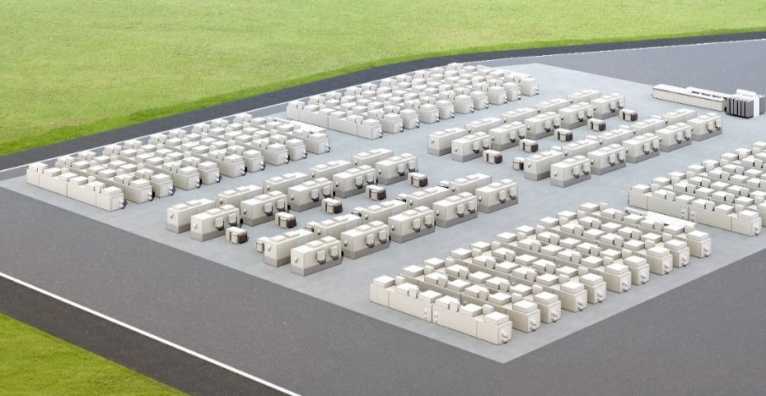
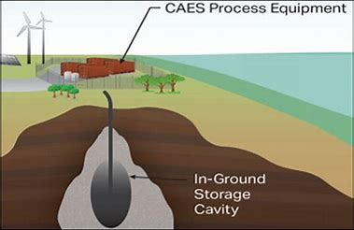
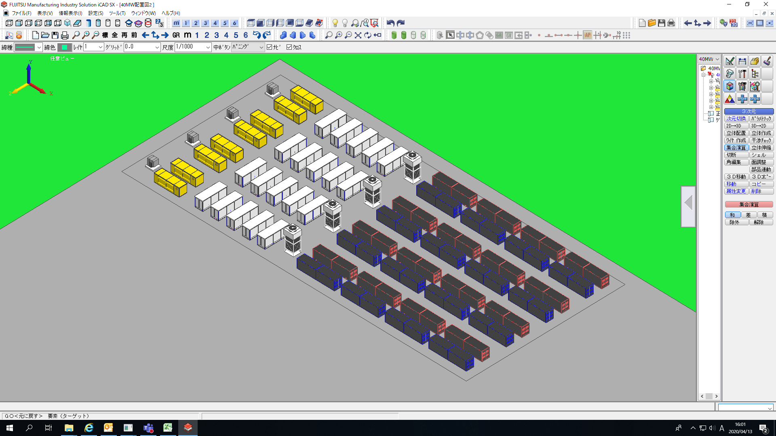
KABTM (A-CAES) vs. Li-ION Batteries
Image of both systems
KAB (A-CAES) external view
Comparison in same MWh
KABTM (A-CAES) cavern type above ground
for 2.5MW 5MWh
Li-ION ENERGY STORAGE 40MWh
Underground salt cavern storage
Renew Economy Clean Energy News and Analysis 2017
KABTM (A-CAES) cavern type above ground
10MW 40MWh

Slide 16
KABTM (A-CAES) vs Li-ION Batteries
advantages of KAB system
COST ADVANTAGE in long duration
Cost for KAB system is competitive in longer durations over 4 hours. This is due to cost increase ratio of cavern storage (for duration hours) is not as steep as Li-ION. Also, as determined by capacity of cavern, very long duration like 24-48 hours is possible. Li-ION installations are typically 4 hours duration or less.
LONGER LIFE of 30 years and no power degradation
Target life of KAB system is 30 years without power degradation. In contrast, life of Li-Ion is 10 years in normal or common usage (much worse in heavy usage). For comparison, first GT-CAES in Alabama has continued operation for 30 years since installation and is still in operation at original capacity.
SAFETY
KOBELCO DRY SCREW is Oil Free type (only Air and Water is used) and no risk of ignition or explosion. Meanwhile, several fire accidents have occurred at Li-ION sites recently.

Slide 17
KABTM (A-CAES) vs Li-ION Batteries
comparison of features

Slide 18
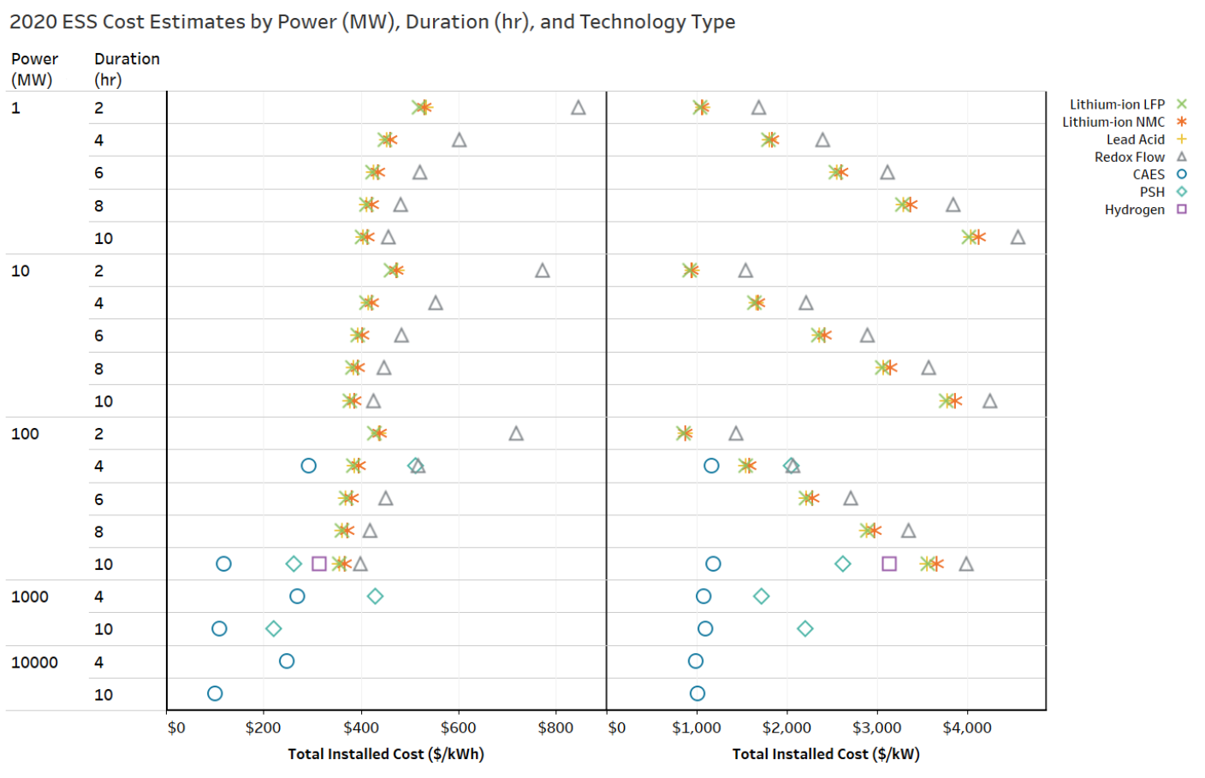
KABTM (A-CAES) vs. Li-ION Batteries
“CAES” means GT-CAES
in this figure.
2020 Grid Energy Storage Technology Cost and Performance Assessment
Publication No. DOE/PA-0204 December 2020

Slide 19
KABTM (A-CAES) vs. Li-ION batteries
Target capital cost comparison
Vertical axis = capital cost in $Millions, Horizontal axis = duration in hours
 | 20MWh | 40MWh | 80MWh | 160MWh | 240MWh | 320MWh | 480MWh
KAB | $32,667,500 | $33,910,000 | $36,395,000 | $41,365,000 | $46,335,000 | $51,305,000 | $61,245,000
Li-Ion | $13,227,100 | $20,667,100 | $35,547,100 | $65,307,100 | $95,067,100 | $124,827,100 | $184,347,100

Slide 20
KABTM (A-CAES) vs. Li-ION Batteries
Target capital cost comparison
Vertical axis = cost in $Ｍillions
Horizontal axis = duration in hours
KAB li-ion

Slide 21
Table of Contents
About KOBELCO / VISION
About the KABTM A-CAES System
Value Comparisons
    Versus GT-CAES
    Versus Li-Ion Batteries
Summary
Appendices

Slide 22
Summary
Advantage of KAB system
New, innovative A-CAES offering
KOBELCO a strong, reliable partner
    For both equipment and ongoing service.
    Based on industry-proven, off-the-shelf equipment.
A-CAES has no carbon emissions
Better value than GT-CAES
    No carbon emissions.
    More flexible, modular scale.
Better value than Li-Ion batteries
    Scalable storage duration up to 48 hours (vs. only 4 hours).
    Lower capital cost.
    Twice the service lifetime.

Slide 23
Table of Contents
About KOBELCO / VISION
About the KABTM A-CAES System
Value Comparisons
    Versus GT-CAES
    Versus Li-Ion Batteries
Summary
Appendices

Slide 25

APPENDIX 1. DEMO PLANT in IZU, JAPAN
Quick facts
Project Member:
NEDO (Government Fund), KOBELCO, WASEDA UNIVERSITY, OTHERS
Location:
Izu Shizuoka, 70 miles west of Tokyo.
Generating output:
Max 1 MW (two-500KW units)
Technology:
A-CAES using Dry Screw Compressor
Input Power:
from Wind Farm nearby, 100% emission free.
Completed :
April 2017 (operated until Nov 2019)
This facility was removed in Nov 2019 when demo was completed.

Slide 26
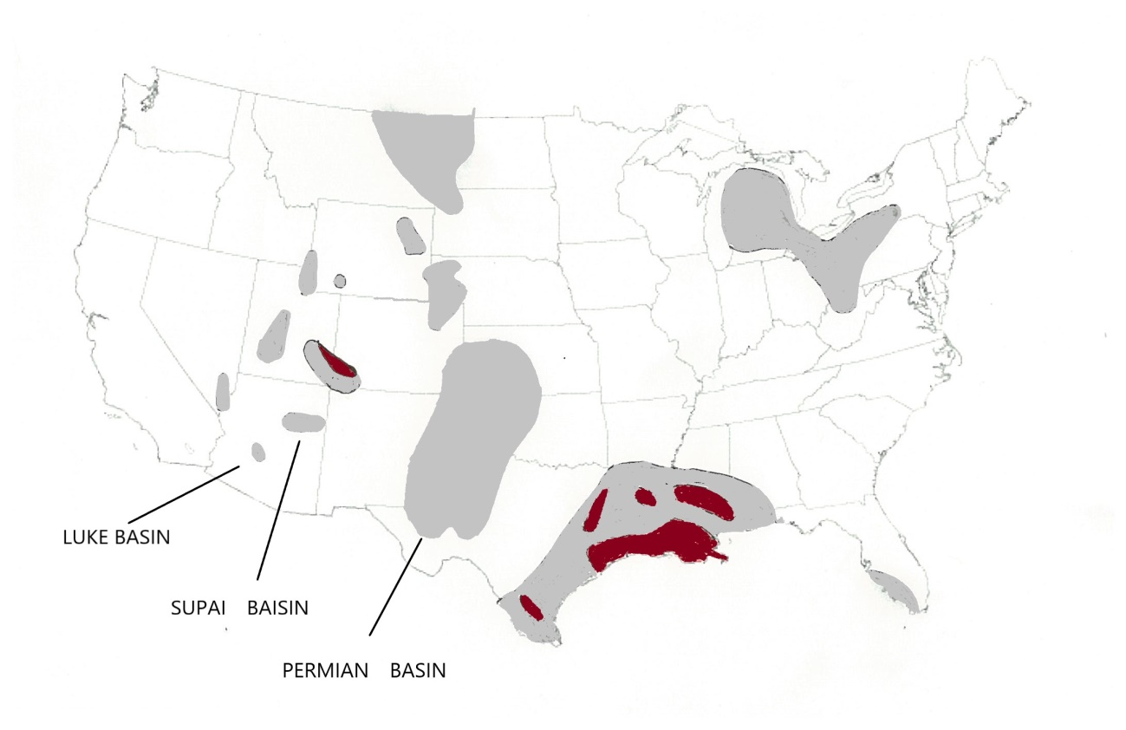
APPENDIX 2-1. SALT CAVERNS in U.S.
location map
GULF COAST BASINS

Slide 27
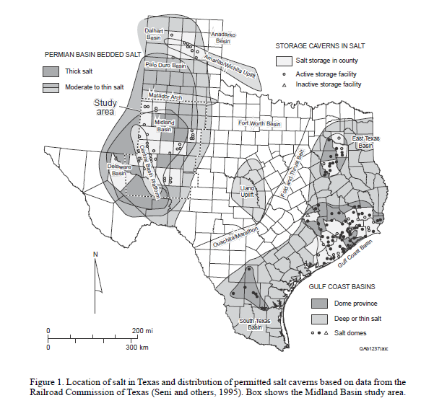
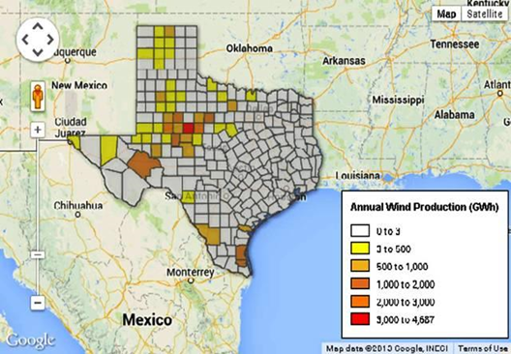
APPENDIX 2-2. SALT CAVERNS and Wind Firms in TEXAS
location map
CAVERN
WIND FIRM

Slide 28
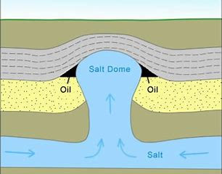
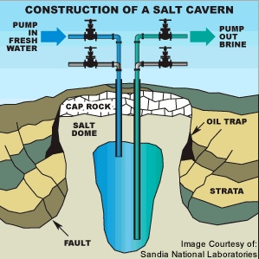
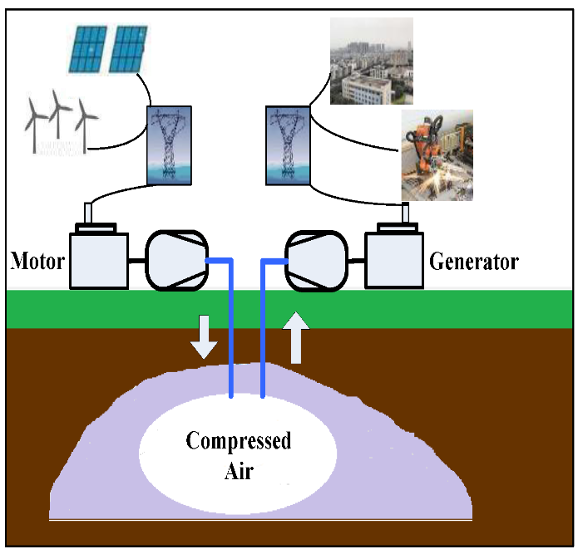
APPENDIX 2-3. SALT CAVERNS in U.S.
basic knowledge
FORMATION OF SALT DOME / BEDDED SALT
CONSTRUCTION OF SALT CAVERN
Eagle Ford Shale, New Marketplace 2014
OPERATION OF GT-CAES WITH CAVERN
MDPI Overview of CAES technology 2017
Location:
Finding an existing and unused cavern is cost effective. Such caverns are typically used for Natural Gas, Liquid Oil or Hydrogen storage.
Best when the cavern is located near Renewable Energy site.
Brine well would be necessary. Or sell brine to salt or chemical companies.
Depth:
Max Pressure (PSIG) = 0.85 x depth of casing shoe (ft)
Min Pressure (PSIG) = 0.30 x depth of casing shoe(ft)

Slide 29
APPENDIX 3. GT-CAES* OUTLOOK
Operational process of GT-CAES using Turbo
GT-CAES system uses a gas turbine or expander-powered generator fueled by natural gas. As a result, it has carbon emissions.
The system converts surplus electricity into compressed air, then stores it in underground spaces.
CO₂ Emissions
Compressor
(low pressure)
Compressor
(high pressure)
Motor/
Generator
Gas turbine
Generator
IC
AC
Combustion
Natural Gas
Generation process
needs natural gas input.
Tank (Underground)
* The term ”GT-CAES” refers to alternative CAES systems that use turbo compressors and fossil fuels in their generation cycle, using either a gas turbine (GT) or expander.

Slide 30
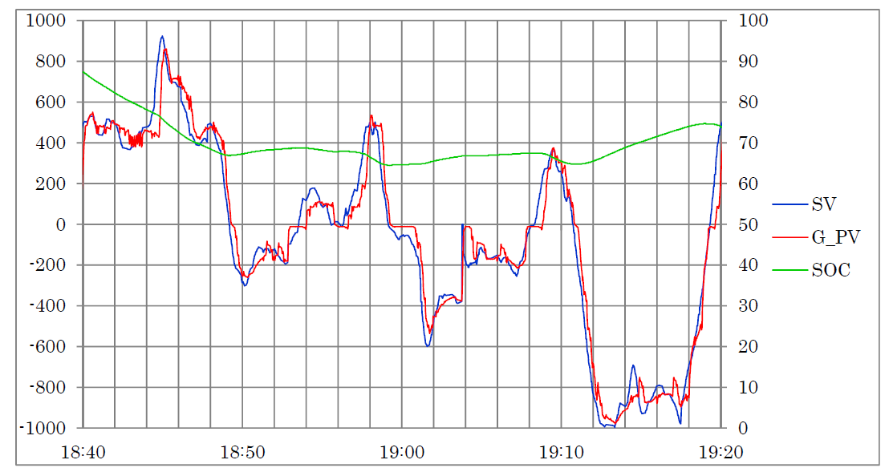
APPENDIX 4. KAB’s High Response
KAB, due to its Dry Screw technology, could respond to the requirement signal ( charge / discharge ) quickly and constantly, while Turbo cannot. Once discharge mode starts, rotors reverse and rotate in opposite direction.
SV=SET VALUE, G-PV=PRESENT VALUE, SOC=State of Charge
KW
%
Discharge
Charge
Source: PJM Interconnection LLC

Slide 31
KOBELCO KAB
TM
THANK YOU!
SV PATHFINDERS as contractor for KOBELCO
19925 Stevens Creek Blvd #100 CUPERTINO, CA, 95014
Contact : Yoshimasa(Yoshi) Masuda CELL: 408-836-9236
masuday@sv-pathfinders.com
www.kobelcocompressors.com

